Slide 1
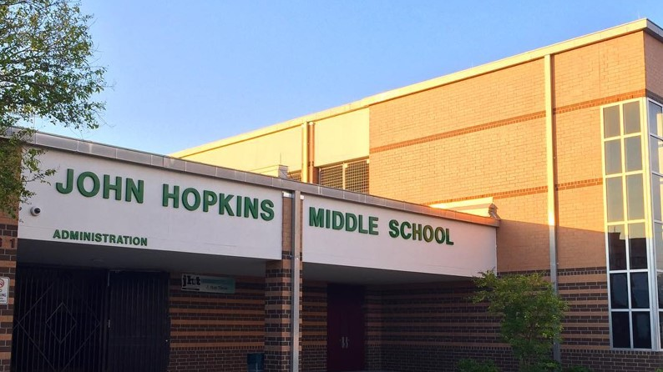
Scholar Enter & Exit School Processes

Slide 2
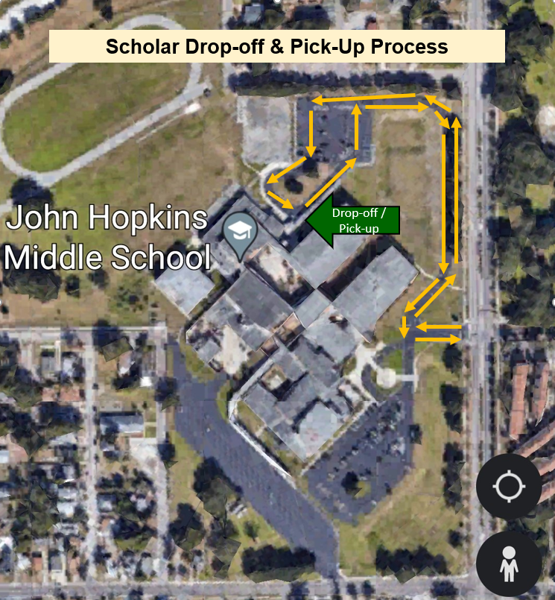
Drop-off (AM)
Scholars will be dropped off at the car circle and will enter campus through the back double doors.
Scholars can remain in the Main Courtyard until the 9:33 bell or eat breakfast in the Cafeteria.
Pick-up (PM)
Scholars go to the Car Circle and wait patiently for their ride.
Scholars are not permitted to walk across the drive to the parking lot to get picked up.
At approximately 4:30 p.m., car riders will be picked up in front of the school.
Enter / Exit Here
Notes:
For scholars who take a ride to and from school by way of a car or private vehicle, you will be dropped off at the Car Circle, which is located on the northern end of campus, behind Building 5 and the Gymnasium. Scholars will be dropped off in the mornings at the Car Circle and will enter campus at the double doors between the Gym and Building 5 and can either remain in the courtyard or go to the Cafeteria for breakfast.
At the end of each school day, car-riders will exit campus from the same doors between the Gym and Building 5 to access the car circle. Scholars are to wait patiently and be on the look out for their ride in the car line. Scholars are not permitted to walk across the drive to the parking lot to get picked up.

Slide 3
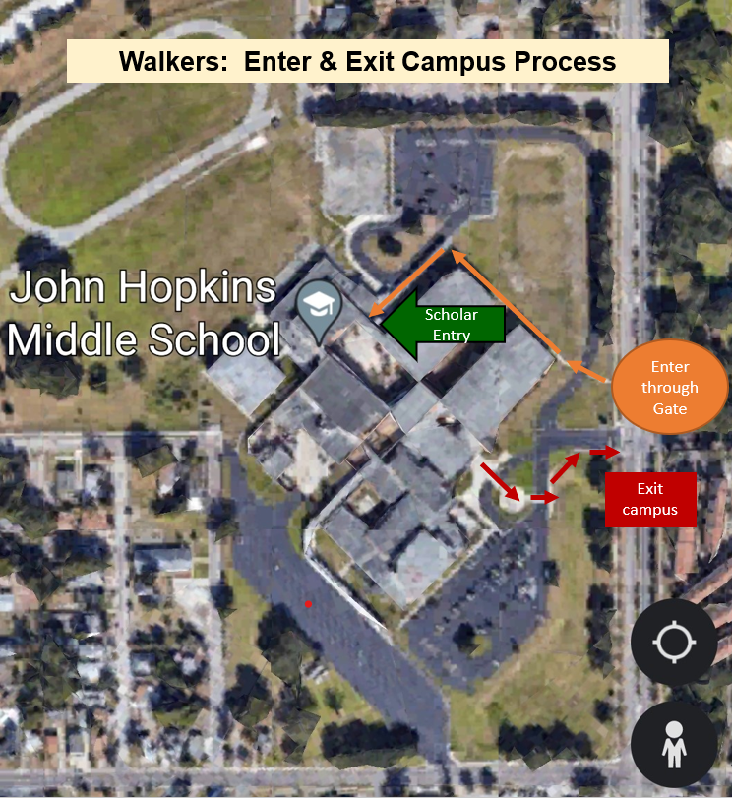
Arriving to Campus (AM)
Walkers will enter campus through the gate just to the north of the drive and take the sidewalk to the back of the school to enter campus.
Scholars can remain in the Main Courtyard until the 9:33 bell or eat breakfast in the Cafeteria.
Exiting Campus (PM)
Walkers will exit campus through the front of school and past the flagpole to the sidewalk just south of the drive.
Scholars will walk south or wait for School Crossing Guard direction to walk north or east across 16th Street.
Exit Here
Notes:
For scholars who will be walking to and from school, you will follow these processes:
In the morning, scholars will enter school grounds through the chain link gate that is located just past the school marquee digital sign. You will cross the drive, when the school official gives you the okay to across, and take the sidewalk to the back of the school and enter campus through the double doors to the main courtyard. Scholars can remain in the main courtyard or go to the cafeteria to eat school breakfast.
At the end of the school day, all walkers will exit campus through the front of the school. Scholars will walk past the flagpole across the drive to the sidewalk just south of the drive and exit campus. Scholars can walk south down 16th Street or wait for direction from the school crossing guard to walk north or east towards Campbell Park.

Slide 4
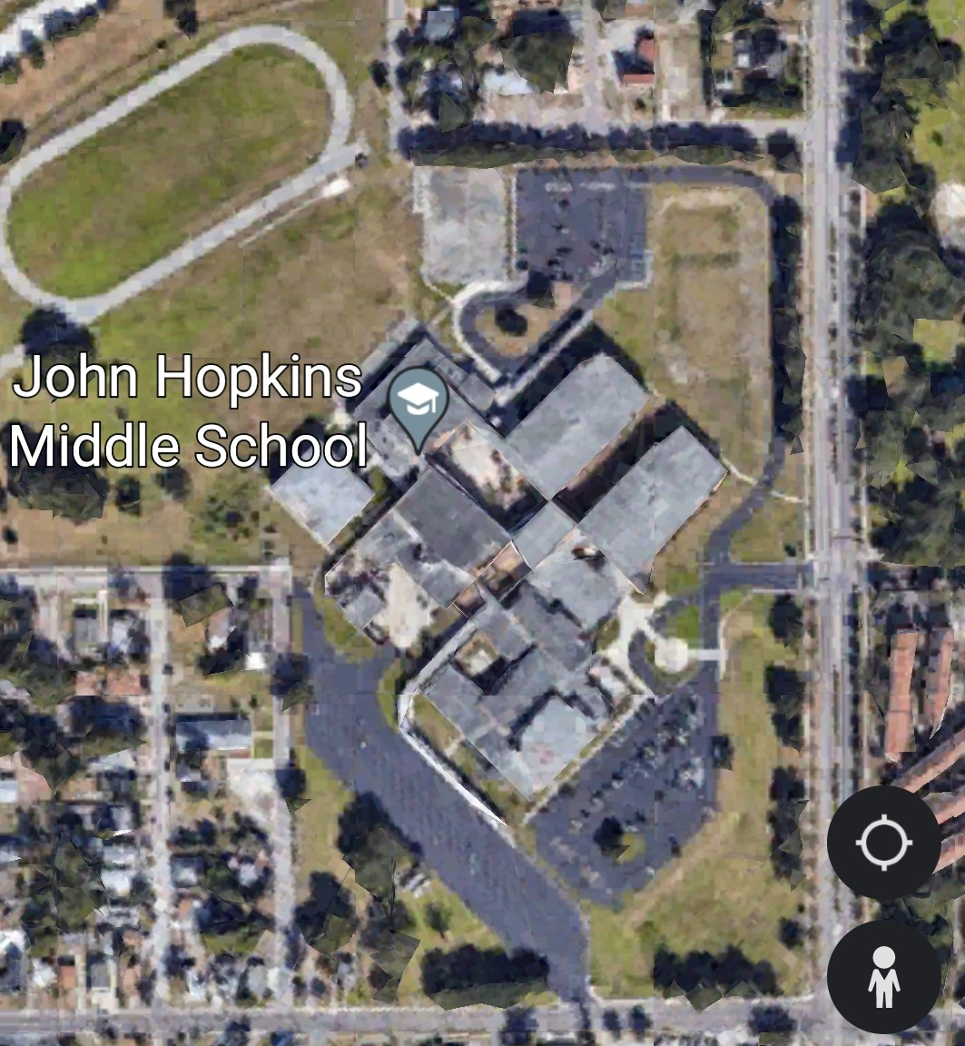
Bike Rider Entry & Exit Process
Arriving to Campus (AM)
Bike riders will enter through the gate located on 6th Avenue South and take the sidewalk path to lock bikes in the bike rack.
Bikers will take the sidewalk and enter campus through the car circle entrance.
Scholars can remain in the Main Courtyard until the 9:33 bell or eat breakfast in the Cafeteria.
Bike Rider Entrance
Exiting Campus (PM)
Bike riders will exit campus through the car circle exit, and ride their bicycle through the gate onto 6th Avenue South.
Bike Rack
Enter / Exit Here
Notes:
Bike riders will enter campus each morning through the chain link gate located on 6th Avenue South. Scholars are to take the sidewalk path to the bike rack. All bike riders should lock their bikes up with a lock. The school is not responsible for a stolen bicycle, especially if you failed to lock it. You will then take the sidewalk and enter campus through the doors between the gym and building 5 to either the courtyard or to the cafeteria for school breakfast.
In the afternoon, scholars who ride bikes will exit campus through the doors between the gym and building 5. Bike riders will then exit campus through the gate at 6th Avenue South to 16th Street and then either go north or south.

Slide 5
Bus Riders: Enter & Exit Campus Process
Drop-off (AM)
Scholars will enter campus between Buildings 2 & 3.
Scholars can remain in the Main Courtyard until the 9:33 bell or eat breakfast in the Cafeteria.
Pick-up (PM)
Scholars will walk to the bus circle and patiently wait for their bus.
Once their bus arrives, scholars will receive direction from the staff member(s) to board the bus.
Bus Riders Enter Campus
Bus Circle
Notes:
For scholars who ride a bus to school, you will be dropped off each morning in the school bus circle. You will enter campus through the steel gate between buildings 2 and 3 and go to the main courtyard or the cafeteria for school breakfast.
At the end of the school day, you will exit towards the bus circle through the steel gate between buildings 2 and 3. While at the bus circle, you will look at the board, which has the busses listed in order by bus number. If your bus has arrived, you may enter the bus. If the bus has not arrived, you are expected to stand and wait patiently or sit on the benches and wait patiently until your bus arrives. Staff members on duty will give approval for when you can board the bus when it arrives.

